Slide 1
Asthma
By Dalia Munoz

Slide 2
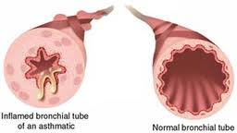
Definition
is a serious and ongoing disease that affects the airways of both adults and children. Airways are the tubes that carry air in and out of the lungs. Asthma is a chronic, long-term disease with no cure, but there are treatments available to help control and prevent asthma symptoms. Talk to your healthcare provider about treatment options that may be right for you.

Slide 3
Age group
2008 | 2009 | 2010 | 2011 | 2012
 | number of persons
Total, 12 years and over | 2,362,902 | 2,308,941 | 2,446,467 | 2,511,890 | 2,385,833
Males | 1,008,455 | 942,971 | 1,016,082 | 1,066,427 | 983,434
Females | 1,354,447 | 1,365,970 | 1,430,386 | 1,445,463 | 1,402,399
12 to 19 years | 381,121 | 396,258 | 370,219 | 385,817 | 327,782
Males | 196,503 | 206,027 | 193,881 | 186,654 | 174,374
Females | 184,618 | 190,231 | 176,338 | 199,163 | 153,408
20 to 34 years | 623,688 | 633,579 | 636,257 | 629,689 | 674,803
Males | 270,300 | 268,480 | 286,635 | 276,831 | 305,216
Females | 353,388 | 365,099 | 349,622 | 352,857 | 369,587
35 to 44 years | 377,931 | 355,232 | 367,135 | 373,597 | 322,316
Males | 156,025 | 138,720 | 150,599 | 167,280 | 135,390
Females | 221,906 | 216,512 | 216,537 | 206,317 | 186,926
45 to 64 years | 658,063 | 586,373 | 755,397 | 781,887 | 684,561
Males | 250,281 | 198,512 | 257,280 | 316,912 | 226,717
Females | 407,782 | 387,861 | 498,117 | 464,975 | 457,844
65 years and over | 322,098 | 337,500 | 317,460 | 340,900 | 376,372
Males | 135,345 | 131,232 | 127,687 | 118,750 | 141,738
Females | 186,753 | 206,268 | 189,773 | 222,150 | 234,634
Note: Population aged 12 and over who report that they have been diagnosed by a health professional as having asthma.

Slide 4
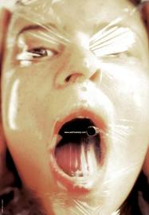
symptoms
Shortness of breath
Chest tightness or pain
Trouble sleeping caused by shortness of breath, coughing or wheezing
A whistling or wheezing sound when exhaling (wheezing is a common sign of asthma in children)
Coughing or wheezing attacks that are worsened by a respiratory virus, such as a cold or the flu

Slide 5
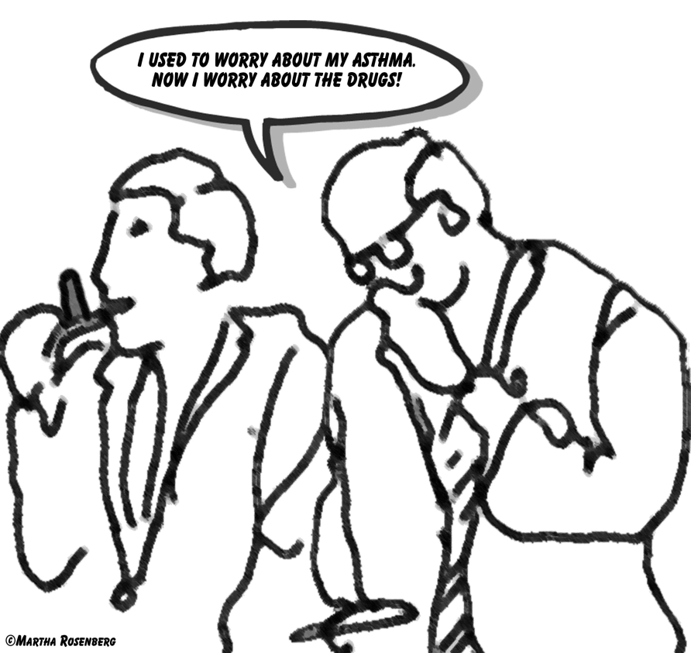
Diagnosis
Physical exam
To rule out other possible conditions — such as a respiratory infection or chronic obstructive pulmonary disease (COPD) — your doctor will do a physical exam and ask you questions about your signs and symptoms and about any other health problems.

Slide 6

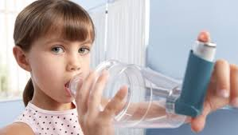
Treatments
Prevention and long-term control are key in stopping asthma attacks before they start. Treatment usually involves learning to recognize your triggers and taking steps to avoid them, and tracking your breathing to make sure your daily asthma medications are keeping symptoms under control. In case of an asthma flare-up, you may need to use a quick-relief inhaler, such as albuterol.

Slide 7
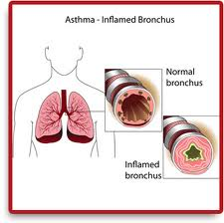
Prognosis
Asthma is usually chronic, although it occasionally goes into long periods of remission. Long-term outlook generally depends on severity:
In mild-to-moderate cases, asthma can improve over time, and many adults even become symptom free.
Even in some severe cases, adults may experience improvement depending on the degree of obstruction in the lungs and the timeliness and effectiveness of treatment.
In about 10% of severe persistent cases, changes in the structure of the walls of the airways lead to progressive and irreversible problems in lung function, even in aggressively treated patients

Slide 8
References
MayoClinic.com
http://health.nytimes.com/health/guides/disease/asthma/prognosis.html
http://www.statcan.gc.ca/tables-tableaux/sum-som/l01/cst01/health49a-eng.htm

