Slide 1
Bursitis
Dalia Munoz
HCP 201
Mrs. Wainio

Slide 2
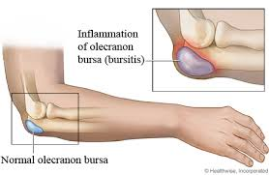
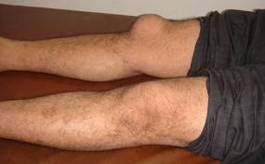
What is Bursitis?
“It is a painful inflammation of the bursa. A bursa sac is located around a joint that contains lubricating fluids that allows muscles and tendons to move freely over bony surfaces. Bursitis occurs most frequently at the hip, shoulder, or knee.”

Slide 3
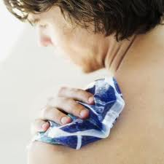
Age Group that has Bursitis
Usually happens to middle aged people, mostly because of trauma, stress, or an inflammation joint disease.

Slide 4
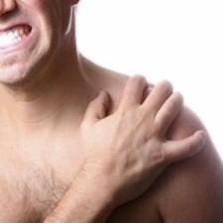
Symptoms
Pain with movement
Limited motion
Gradual or severe pain depending on which joint is being affected.

Slide 5
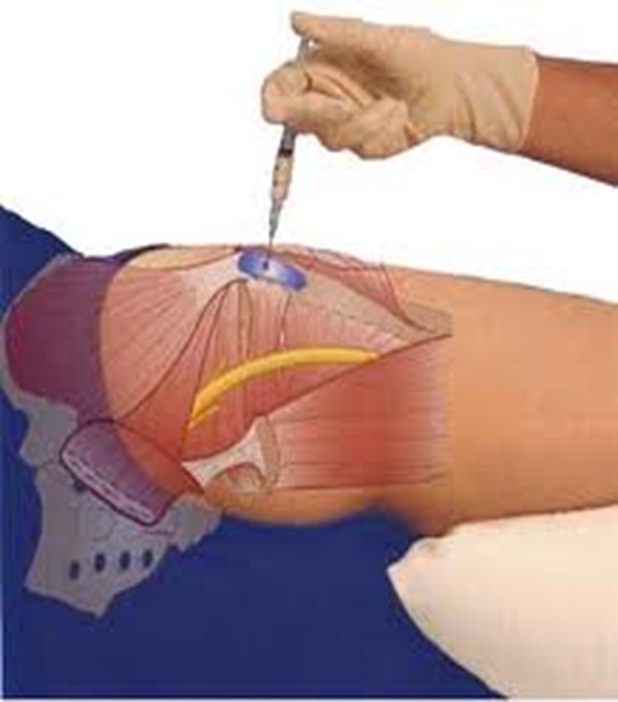
Treatments
Joint rest
Immobilization
Pain medication
Bursal injection combined with a steroid and anesthetic.
Physical therapy

Slide 6
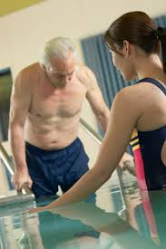
Prognosis
I can be chronic after it develops several times. It is also acute once the joint has trauma and infection.

Slide 7
References
Medical Assisting Book
Google images

