Slide 1
Ulcerative Colitis
Dalia Munoz

Slide 2
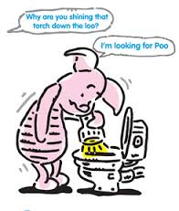
Definition
Its an inflammatory bowel disease (IBD) that causes a long-lasting inflammation in your digestive tract.

Slide 3

Symptoms
Abdominal pain
Blood in your stool
Ongoing bouts of diarrhea that don't respond to over-the-counter (OTC) medications
An unexplained fever lasting more than a day or two

Slide 4
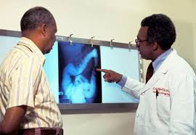
Diagnostic
“Your doctor will likely diagnose ulcerative colitis only after ruling out other possible causes for your signs and symptoms, including Crohn's disease, ischemic colitis, infection, irritable bowel syndrome (IBS), diverticulitis and colon cancer.”

Slide 5
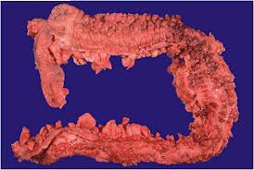
Treatments
Anti-inflammatory drugs
Surgery
Anti-biotics

Slide 6
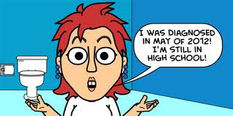
Who gets it?
Ulcerative colitis usually affects people 15 to 30 years old. It does not have a gender preference

