Slide 1
osteoporosis
By: Dalia Munoz

Slide 2
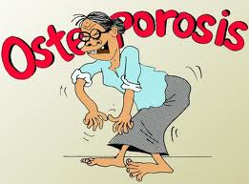
What causes Osteoporosis
Osteoporosis is a disease in which the bones are most likely to break.
People with osteoporosis most often break bones in the hip, spine, and wrist.

Slide 3
Who is most likely to have osteoporosis
More than 80% of woman have this disease.
1-2 woman and 1-8 men over than age of 50 will have an osteoporosis- related fracture during their lives.
White and Asian woman are most likely to get this disease.
Family history of the disease and early menopause or small body's are at greater risk to develop this type of disease.

Slide 4
Does it affect men?
No because they have a larger skeleton and their bone loss starts later and slower plus they don’t have a period of rapid hormonal changes which in turn leads to bone loss
However the main problem of osteoporosis in them has been recognized as an important public health issue, men above the age of 70 will continue to increase the chances.

Slide 5
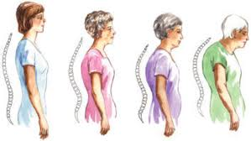
symptoms
There are not any symptoms in their early stages of the bone loss. Once the bones have been weakened by the disease you might have signs that include:
Back pain
Loss of height
Stooped posture
And bone fractures

Slide 6
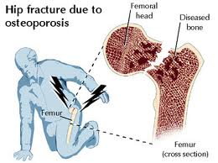
diagnosis
This disease is not diagnosed until the bones have weakened and has lead to a broken bone.
An x-ray can not be measure the bones density but is used to identify spinal fractures

Slide 7
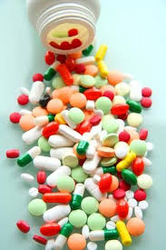
Is there any treatment
For both men and woman the most widely prescribes osteoporosis medications are bisphosphonates which includes:
Alendronate
Risedronate
Ibandronate
Zoledronic acid

Slide 8
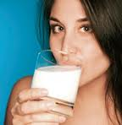
prevention
Whether you develop this disease depends on the thickness of your bones early in life but also on your health, diet, physical activity
Thickness in your bones the less likely you are to become thin enough to break.

Slide 9
references
Health info
webMD
Google
Your disease risk

